Slide 1
Impacts and Valuation
Science and scenarios
Abatement costs
Instruments for emission reduction
Impacts of climate change; valuation
Economic impacts; marginals; distribution
Impacts and development
Adaptation policy
Optimal climate policy
Discounting, equity, uncertainty

Slide 2
Impacts of Climate
Changing temperatures, precipitation and atmospheric composition affect plants and animals, both in managed and in unmanaged systems

Slide 3
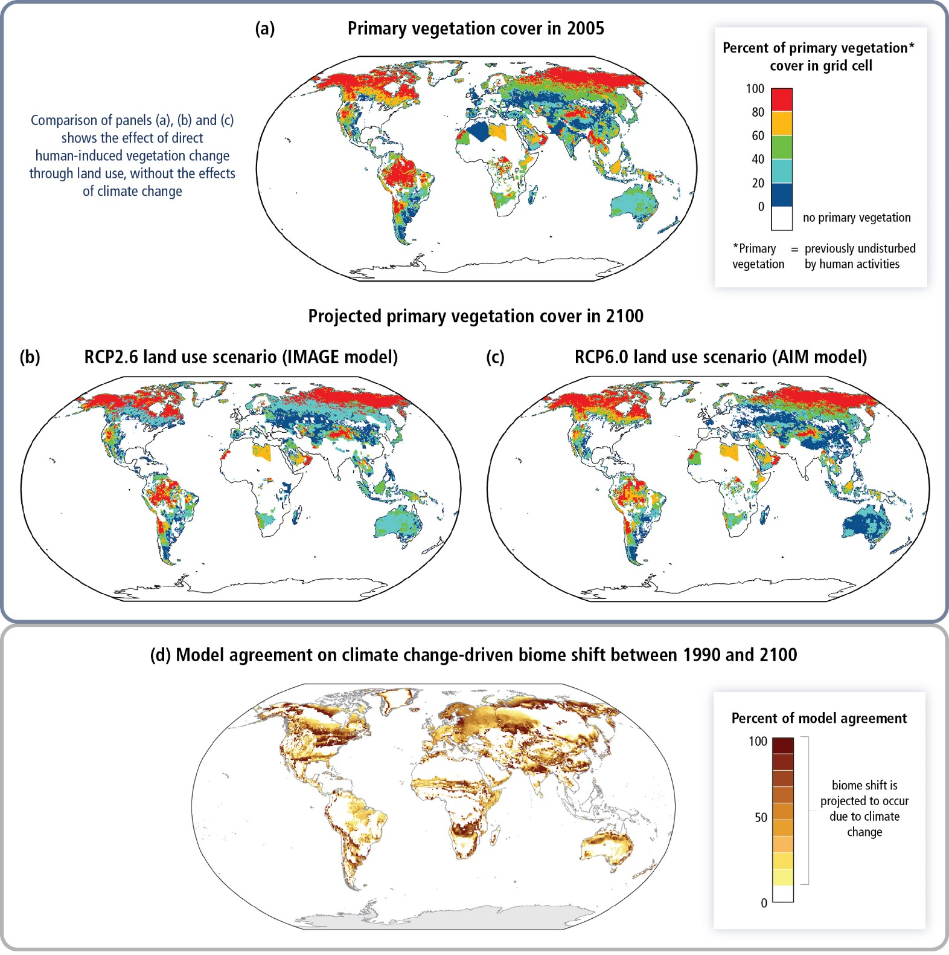

Slide 4
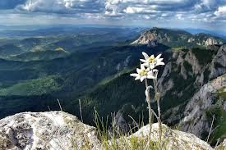
Impacts of Climate
Changing temperatures, precipitation and atmospheric composition affect plants and animals, both in managed and in unmanaged systems
The specialised are likely to loose, as are the marginalised

Slide 5
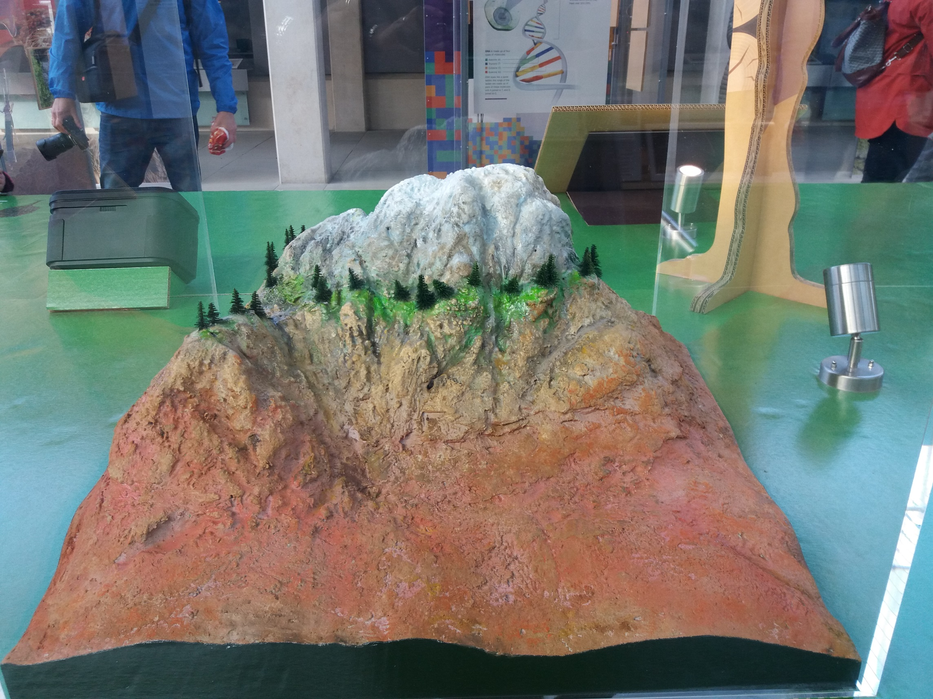
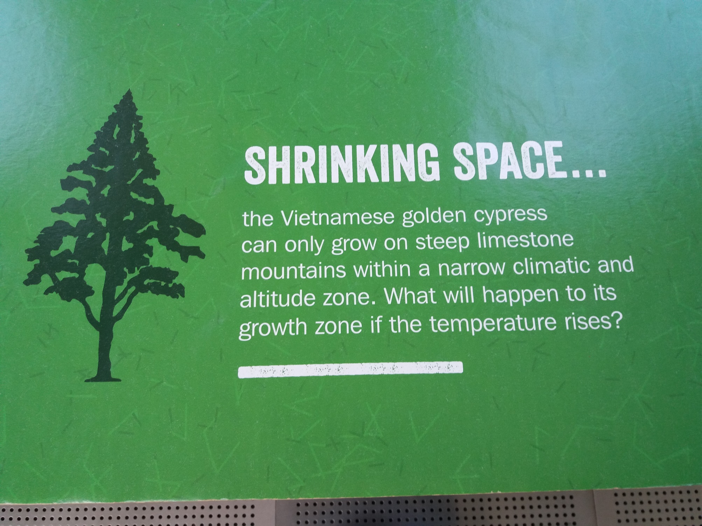

Slide 6
Impacts of Climate
Changing temperatures, precipitation and atmospheric composition affect plants and animals, both in managed and in unmanaged systems
The specialised are likely to loose, as are the marginalised
Climate change affects water (for drinking, irrigation, cooling), droughts and floods

Slide 7
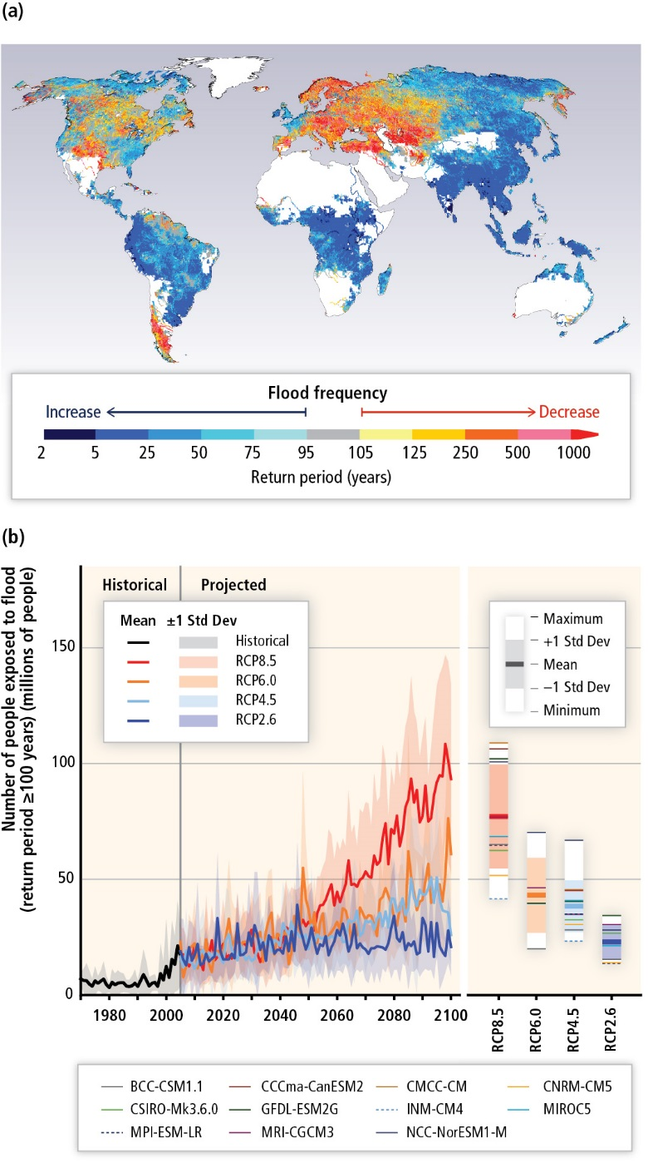

Slide 8
Impacts of Climate
Changing temperatures, precipitation and atmospheric composition affect plants and animals, both in managed and in unmanaged systems
The specialised are likely to loose, as are the marginalised
Climate change affects water (for drinking, irrigation, cooling), droughts and floods
Climate change affects energy production and consumption; tourism; construction; transport; labour productivity and so on

Slide 9
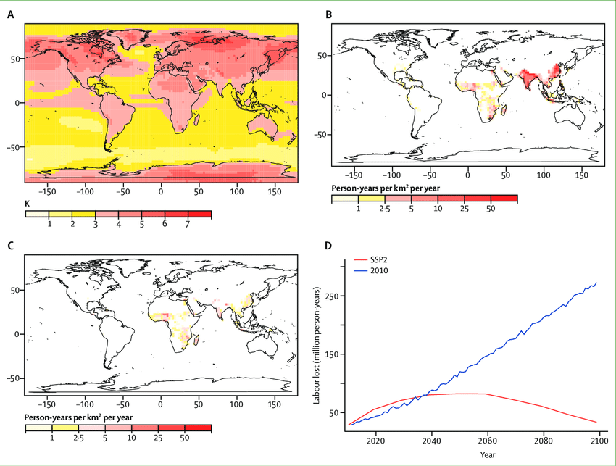
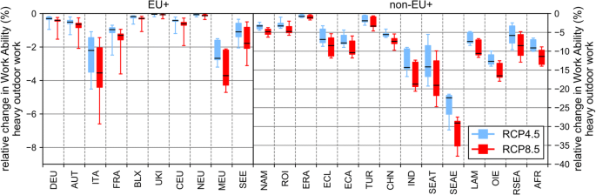

Slide 10
Impacts of Climate -2
Climate change also affects human health, through heat stress (cardiovascular, respiratory), cold stress (cardiovascular), vector-borne diseases (malaria, dengue fever, schistosomiasis), other infectuous diseases (cholera), water and food quantity and quality, air pollution, and extreme weather events

Slide 11
Impacts of Climate -3
Sea level rise leads to land loss

Slide 12
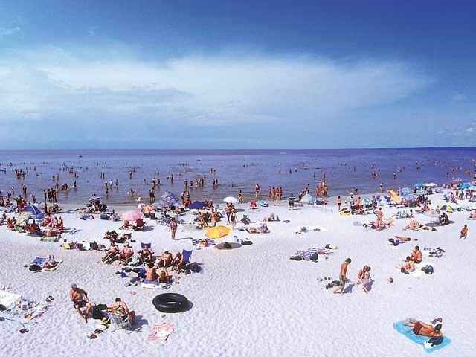

The Gruenspecht Rule of Adaptation

Slide 13
Impacts of Climate -3
Sea level rise leads to land loss and higher costs for coastal protection, wetland loss, saltwater intrusion

Slide 14
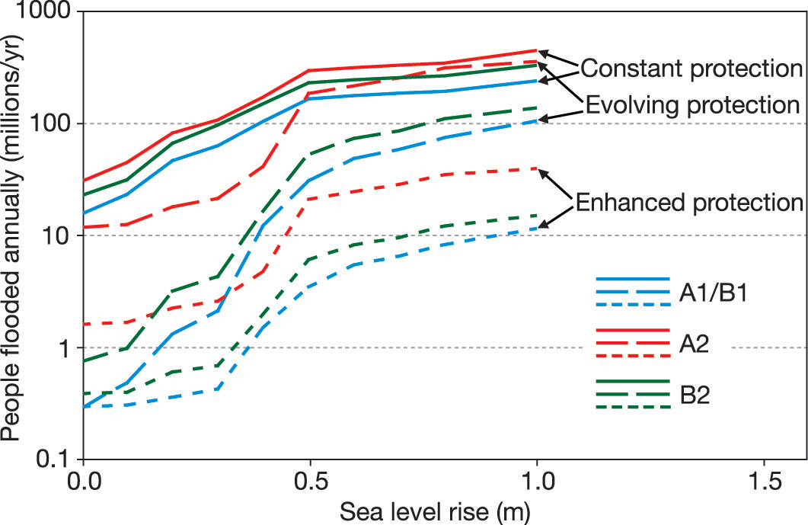

Slide 15
Impacts of Climate
Changing temperatures, precipitation and atmospheric composition affect plants and animals, both in managed and in unmanaged systems

Slide 16
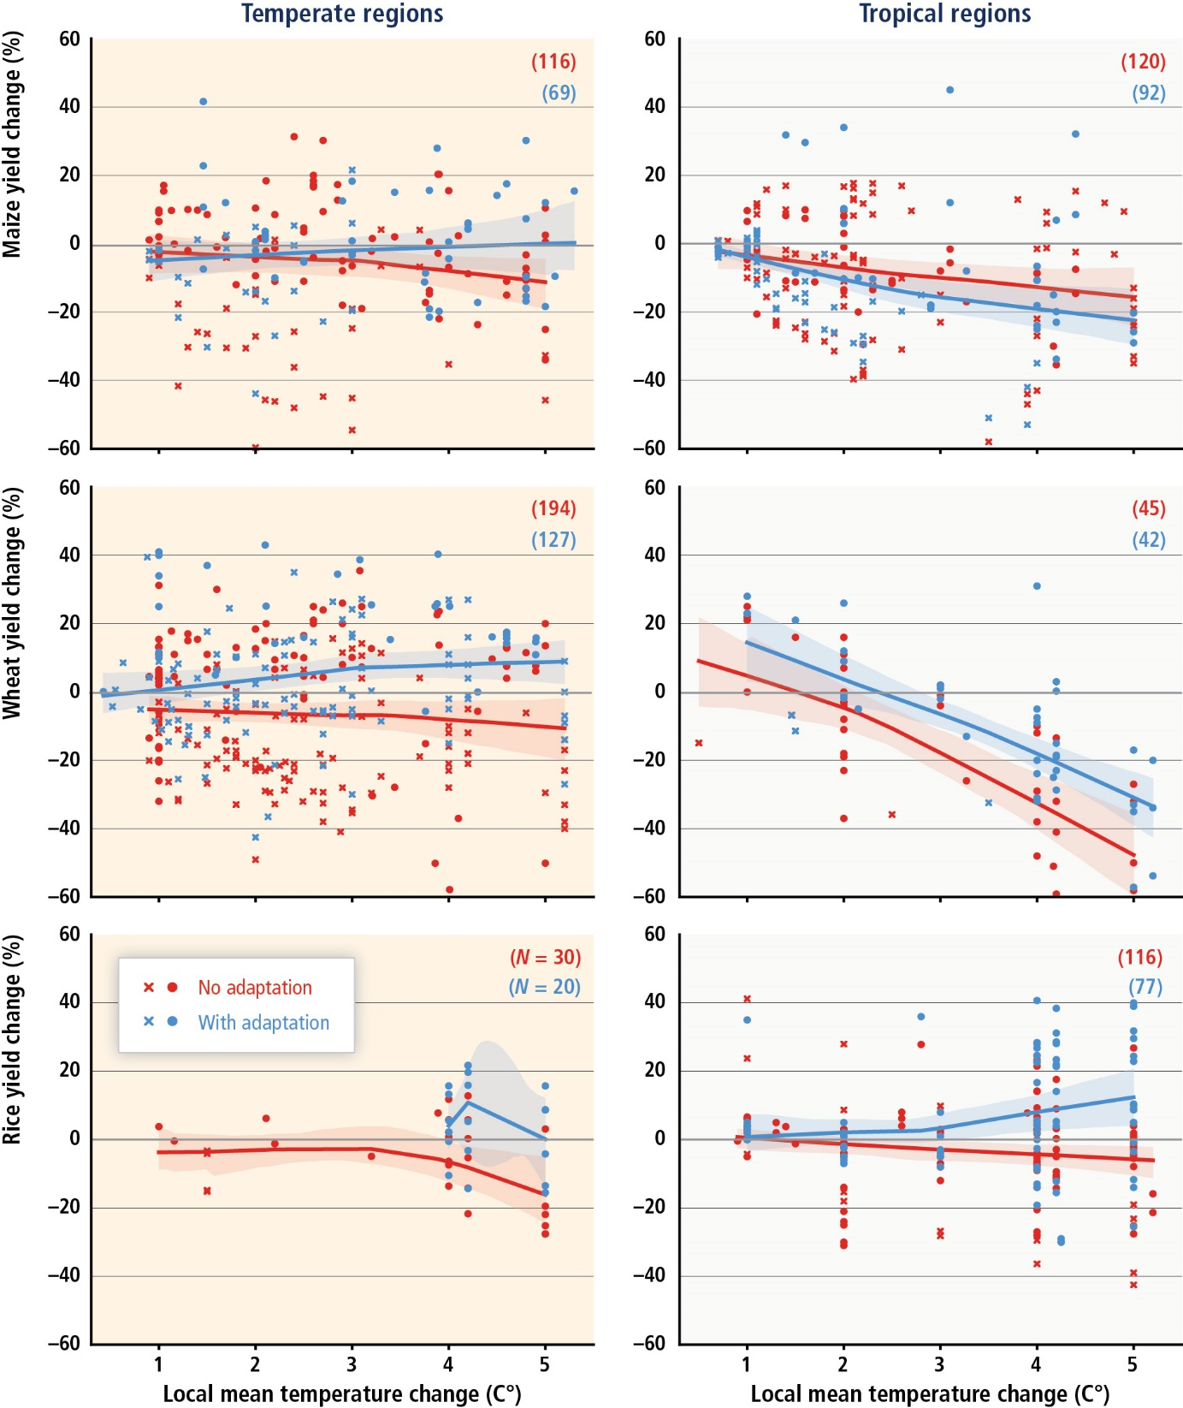

Slide 17
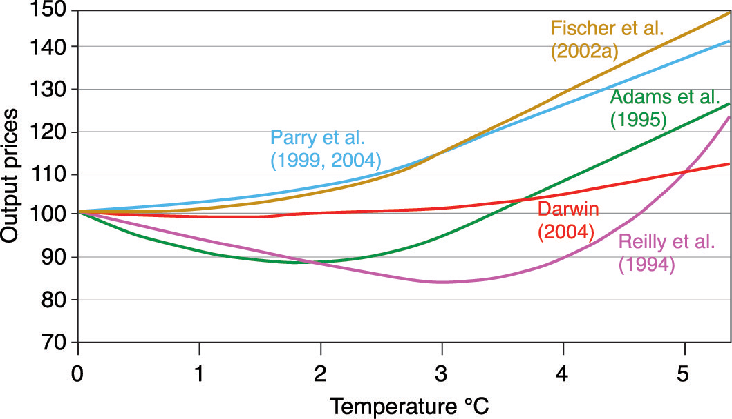

Slide 18
Impacts of Climate
Climate change has many different impacts, with different effects for different countries, sectors, times
If one wants to get insights, high level indicators need to be used

Slide 19
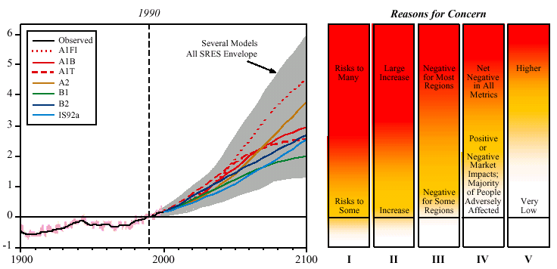
Global mean warming ºC
Year
I Risks to Unique and Threatened Systems
II Risks from Extreme Climate Events
III Distribution of Impacts
IV Aggregate Impacts
V Risks from Future Large-Scale Discontinuities
Source: IPCC 2001

Slide 20
Impacts of Climate
Climate change has many different impacts, with different effects for different countries, sectors, times
If one wants to get insights, high level indicators need to be used
If one wants to compare the impacts of climate change to the impacts of emission reduction, include the impacts in the national accounts, or determine how much compensation should be paid, money is the appropriate indicator

Slide 21
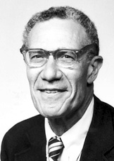
[E]conomists have the reputation of being unimaginative bean-counters, doggedly claiming to quantify the unquantifiable [...] and personifying Oscar Wilde‘s definition of a cynic as someone who knows the price of everything and the value of nothing. [...] It is true that [economists] would give a lot for a rough quantitative answer; but that only reflects the fact that any policy can be pushed harder or less hard, further or less far, and that a useful evaluation has to suggest how hard and how far. The beans have to be counted, if only approximately: those gentle souls who merely ooh and ah over them are arguably part of the problem, not part of the solution.
Robert M. Solow

Slide 22
Benefit-cost analysis
If an optimum is sought, the marginal external cost function must be estimated, and expressed in money
B
>
O
>
A
A
C
CBA: W=X+aY
?
>
MCA: W=f(X,Y)
O
>
?
B
D

Slide 23
Monetary Valuation
The aim is to express a welfare loss in an equivalent income loss
Revealed preferences
Travel cost
Hedonic pricing
Stated preferences
Contingent valuation
Contingent choice
Each method has its drawbacks, but stated preferences suffer from a range of biases, including unfamiliarity and manipulation

Slide 24
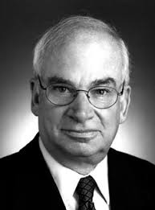
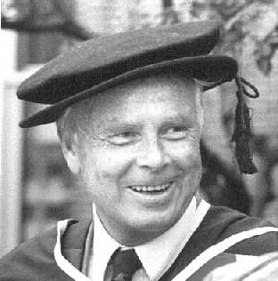
Hedonic Pricing
We try to estimate the demand curve for a non-market good by observing market behaviour in the market for the related good
HPM uses a market good with which the non-market good is implicitly traded
Property prices also reflect environmental amenities
Example noise pollution: House in a quiet area is likely to be more expensive than identical house in noisy area
Complication: Same is true for wages!
Notes:
Sherwin Rosen, Kelvin Lancaster

Slide 25
Hedonic Pricing -2
Step 1: Collect data
Step 2: Estimate the price differential due to the environment using multiple regression:
Property price = f(property variables, neighbourhood variables, accessibility variables, environmental variables)
Step 3a: Differentiate the hedonic price function to one characteristic and derive willingness to pay
Step 3b: Invert hedonic price function to demand function for environment, and integrate to derive welfare change

Slide 26
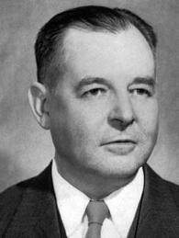
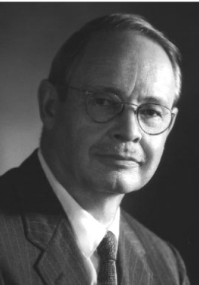
Travel Costs
Method to value the use of natural resources for recreational purposes
Access to recreational sites command seldom a price
Basic premise: time and travel cost expenses to visit the site represent the „price“
TWP to visit a site can be estimated by the number of trips that they make at different travel costs
Proceed as above, with hedonic pricing
Notes:
Harold Hotelling, Marion Clawson

Slide 27
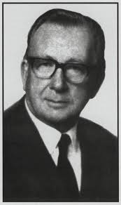
Contingent Valuation
Interview people, ask them for their willingness to pay for certain environmental goods and services
Advantage: Applicable to more than direct use value
Disadvantages: Hypothetical, people are unfamiliar with the situation, all sorts of biases may occur, interview design is always hard
Notes:
Siegfried von Ciriacy Wantrup

Slide 28
CVM: Potential Biases
Strategic bias: respondents deliberately under/overestimate their WTP
Free-ride
Government pays
Design
Payment vehicle: taxes, price increases etc.
Informational
Hypothetical bias
Budget constraint
Unfamiliarity (operational)
Interviewer bias
Warm glow: positive WTP because they feel good about the act of giving for a social good

Slide 29

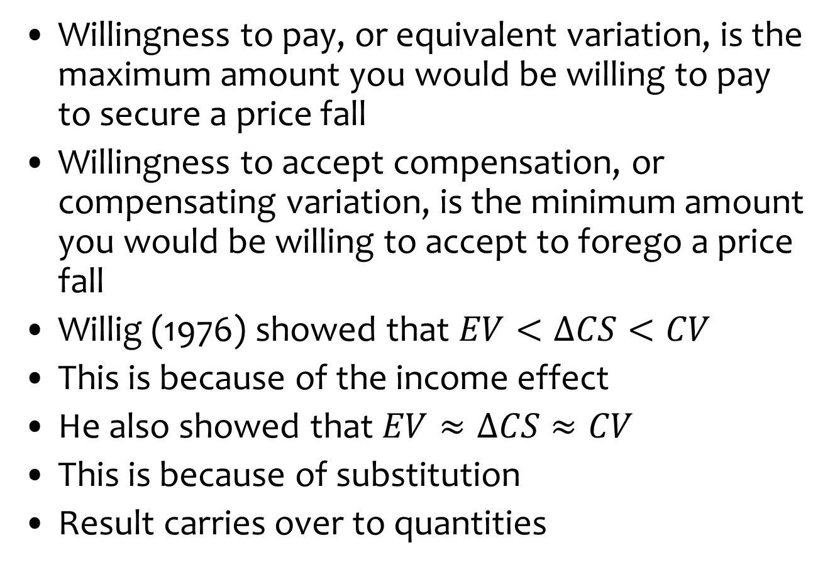
WTP v WTAC
Willingness to pay, or equivalent variation, is the maximum amount you would be willing to pay to secure a price fall
Willingness to accept compensation, or compensating variation, is the minimum amount you would be willing to accept to forego a price fall
Willig (1976) showed that $EV<ΔCS<CV$
This is because of the income effect
He also showed that $EV≈ΔCS≈CV$
This is because of substitution
Result carries over to quantities
Notes:
Robert Willig

Slide 31
WTP and WTAC -2
Willingness to pay and willingness to accept compensation are different, because
the budget constraint is different
voluntary and involuntary risks are different
people attach value to the status quo
Important for climate change
Buy a better climate for your children and grandchildren
Compensate your children and grandchildren for imposing a worse climate on them
Those who suffer the worst impacts contributed least to climate change

Slide 32
Benefit transfer
Monetary valuation is difficult and expensive
Therefore, estimated values are extrapolated (benefit transfer) from one place to the next and from one case to the next
For climate change, we need a comprehensive assessment, rather than case studies, of future values, rather than past values
Two approaches
Value transfer (quickly abandoned)
Function transfer
As values are highly context-specific, benefit transfer introduces all sorts of uncertainties, which are not well-understood

Slide 33
Authors (year) | Method | Resources valued | N | % error
Barton (2002) | CV | Beach quality | 8 | −20 (−23, −10)
Bergland et al. (1995) | CV | Water quality | 2 | −21 (−24, −18)
Brouwer and Bateman (2005) | CV | Human health | 85 | 17 (−41, 123)
Brouwer and Spaninks (1999) | CV | Farm land | 8 | 3 (−59, 60)
Colombo and Hanley (2008) | CM | Farm land | 178 | 680 (2, 7496)
Colombo et al. (2007) | CM | Soil conservation | 54 | 110 (8, 1148)
Groothuis (2005) | CV/TC | Deer hunting | 120 | −10 (−75, 136)
Hanley et al. (2006) | CM | Ecosystem health | 2 | −72 (−78, −67)
Jiang et al. (2005) | CM | Coastal land | 5 | −68 (−85, −53)
Johnston and Duke (2009) | CM | Farm land | 4 | −76 (−100, −29)
Johnston (2007) | CM | Mixed resources | 24 | −12 (−101, 58)
Kerr and Sharp (2006) | CM | Ecosystem health | 22 | 79 (−63, 704)
Kristofersson and Navrud (2007) | CV | Fishing/ecosystem health | 21 | 125 (7, 319)
Lindhjem and Navrud (2008) | META | Multiple use forestry | 16 | 73 (25, 266)
Loomis et al. (1995) | TC | Reservoir | 56 | 106 (−50, 475)
Loomis (1992) | TC | Sport fishing | 10 | 0.2 (−18, 9)
Matthews et al. (2009) | CV | Forest recreation | 84 | 12 (−42, 125)
Morrison and Bennett (2006) | CM | Ecosystem health | 28 | −25 (−171, 30)
Morrison et al. (2002) | CM | Wetlands | 9 | −32 (−66, −4)
Parsons and Kealy (1994) | RUM | Water recreation | 11 | −4 (−66, 75)
Piper and Martin (2001) | CV | Water supply | 8 | 35 (−9, 149)
Ready and Navrud (2007) | CV | Human health | 2 | 39.1 (37.7, 41.9)
Ready et al. (2004) | CV | Human health | 21 | 37 (20, 83)
Rosenberger and Loomis (2000) | META | Mixed resources | 115 | 17 (−79, 319)
Rozan (2004) | CV | Air quality | 4 | −27.5 (−28, −27)
Shrestha and Loomis (2003) | META | Mixed resources | 34 | 60 (−74, 411)
Shrestha and Loomis (2001) | META | Outdoor recreation | 18 | 6 (−46, 81)
Stapler and Johnston (2009) | META | Sport fishing | 4 | 228 (64, 572)
Vandenberg et al. (2001) | CV | Ground water | 8 | 29 (16, 44)
Zanderson et al. (2007a) | RUM | Forest recreation | 6 | 4 (−66, 55)
Zanderson et al. (2007b) | RUM | Forest recreation | 104 | 180 (−73, 1111)

Slide 34
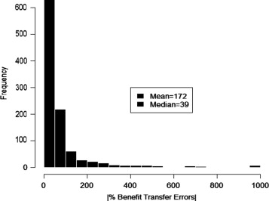
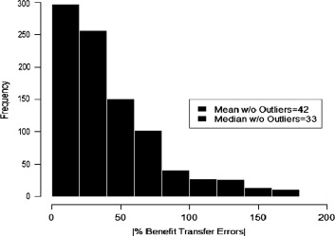
Kaul et al., 2013, JEEM

Slide 35
